Slide 1
Building SW Everyone Can Trust
Safety Requirements on SW in Automotive Applications

Slide 2
Agenda
Why SW is safety-relevant?
Technical understanding of Safety. ASIL
Lifecycle
Coverage
Methods and measures
Independence and decomposition

Slide 3
Why SW is safety-relevant?

Slide 4
SW is literally everywhere
“Old” (automotive) functions – SW for performance
Engine control
Braking control
Passive safety
“New” functions – SW is essential
Active safety
ADAS
Autonomous driving

Slide 5
SW failures are systematic failures
Once made, SW bugs will exist in any number of SW copies
Putting more SW units work in parallel without redundancy does not help
No probabilistic model!
Therefore, process is important!

Slide 6
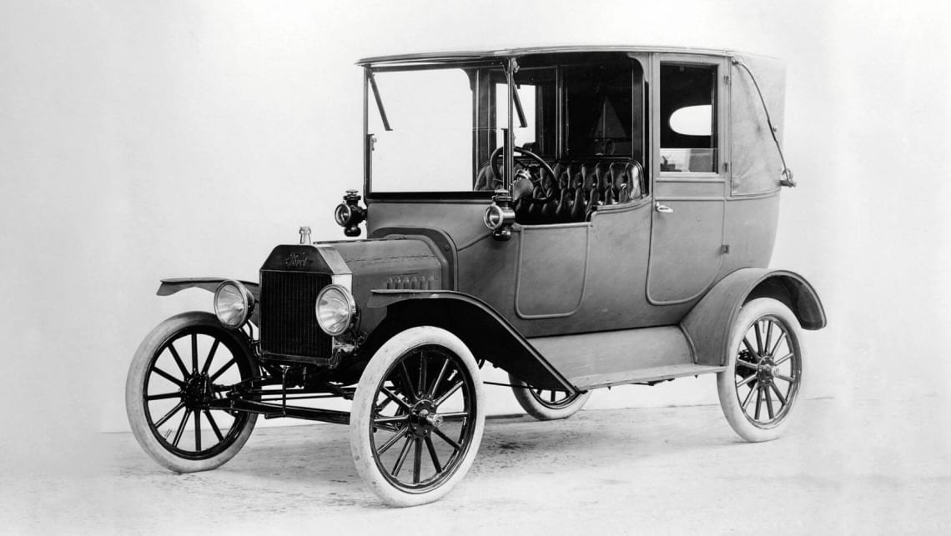
SW is new but the automobile is not
People inside: 1 to ~200
Weight: 600 to 75 000 kg
People outside: many more
Velocity: up to 60 m/s
DANGER!

Slide 7
Technical understanding of Safety. ASIL
Quantifying universal needs

Slide 8
What is Safety?
Safety – absence of unreasonable risk in the presence of hazards
Unreasonable risk – risk acceptable from the standpoint of societal moral concepts
Risk – combination of probability of a harmful event and the severity of harm it causes
Hazard – potential source of harm

Slide 9
We have to agree that…
Risk acceptability is independent of most factors:
Society (country, region, culture, religion…)
Person (gender, age, beliefs…)
Situation (victim – pedestrian / driver, reckless / cautionary)
Harm (leg vs. arm, deafness vs. blindness)
It doesn’t work like that! However, that’s the current state of the art
More details: The Moral Machine by MIT Media Lab, “World Values Map” by Engelhard, Cultural Theory of Risk

Slide 10
Now everything is easy…
Risk
SYSTEM 2
Non-safe system
Safety measures
Acceptable risk
System “made safe”
SYSTEM 2
SYSTEM 1
System which is safe by default
(risks it bears are acceptable)

Slide 11
Necessary elements of the safety lifecycle
Any safety lifecycle has those elements (automotive, avionics, nuclear, …)
Risk
Preliminary risk
assessment
SYSTEM 2
Оценка мер безопасности
(«How safe is safe enough?»)
Risk assessment
Safety validation
SYSTEM 2
SYSTEM 1

Slide 12
Different “flavors” of safety
Why there are many “safeties” (electric safety, functional safety, safety of the intended functionality etc.)
Different hazards require different ways of protection
Bureaucracy
Local, national and international legislation
Industrial regulation
Traditions

Slide 13
Different hazards require different safety measures
(focusing on automotive engineering)
Hazards
«From within»
«From outside»
Component failures
Human actions
Environment
Intentional
Unintentional

Slide 14
Different hazards require different safety measures
(focusing on automotive engineering)
Hazards
«From within»
«From outside»
Component failures
Human actions
Environment
Intentional
Unintentional
Functional safety
Cybersecurity
ISO 21448 “Safety of the Itended Functionality”

Slide 15
Functional safety
Absence of unreasonable risk related to component malfunction
Malfunction – system failure or change of system behavior violating the development goals
There is no formal definition for development goals
Analysis is required

Slide 16
We have to agree that…
Following the predefined lifecycle decreases risks (increases safety)
Risk acceptable by social moral concepts can be defined by one standard worldwide
Safety assessment can be reduced to the assessment of safety arguments
It seems valid. There is nothing refuting those statements.

Slide 17
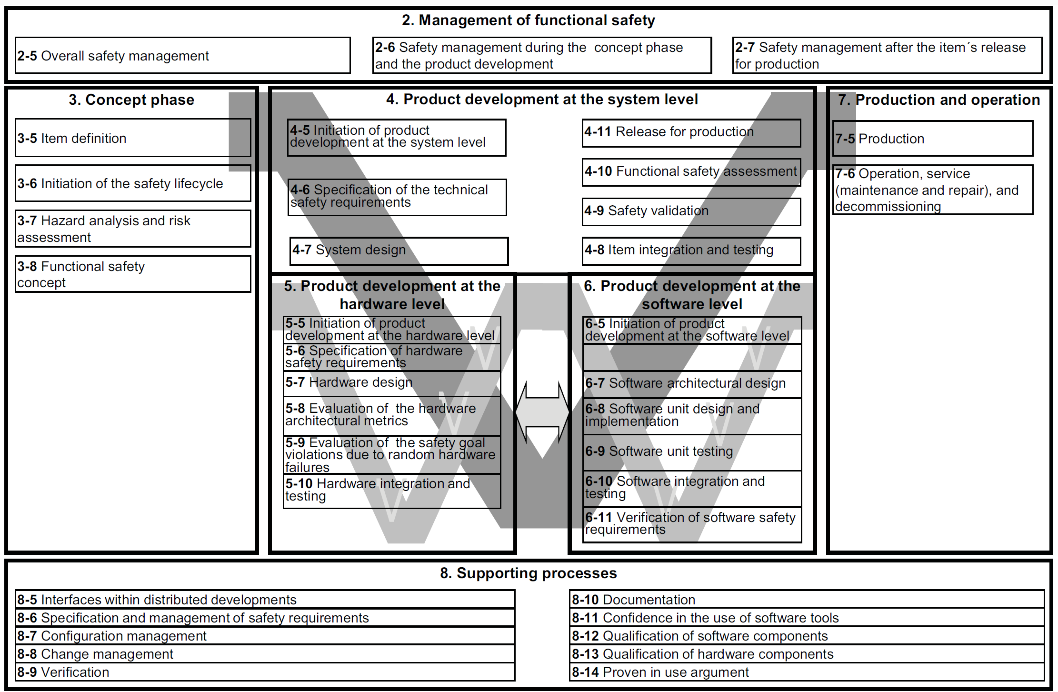
ISO 26262 Lifecycle

Slide 18
ISO 26262 introduces ASILs
Risk associated with system failure exceeds the acceptable level significantly
“Minimum” safety measures required
Risk
“Maximum” safety measures required
System is “a bit unsafe”
Acceptable Risk
…
QM
ASIL A
ASIL D
Automotive Safety
Integrity Level (ASIL)

Slide 19
ISO 26262 on this picture
Risk
Hazard analysis for target ASIL determination
SYSTEM 2
System analysis for definition of required safety measures
Acceptable level of risk set implicitly by the standard
HW & SW analysis validate
the assumptions made on
system level.
SYSTEM 2
SYSTEM 1

Slide 20
Lifecycle
Software safety lifecycle per ISO 26262-6

Slide 21
ISO 26262 Part 6

Slide 22
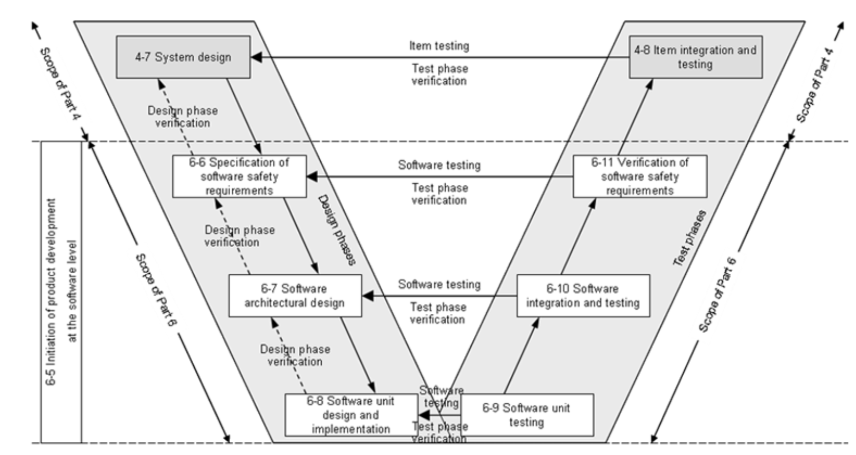
SW development lifecycle

Slide 23
SW development lifecycle
Specification of SW safety requirements
SW safety requirements are created based on the system-level requirements
Requirements of different levels are linked by “traces” (UML/SysML <<implement>>) link. Traceability graph is created.
SW safety requirements (SSR) inherit ASIL from system-level (SysR) requirements
If two or more SSR implement one SysR, “ASIL decomposition” is applied to reduce the ASIL due to redundancy
Writing requirements is a separate skill
Requirement shall be verifiable, atomic, clear, complete and many more
“Requirement Writing Guide” from INCOSE is a good start

Slide 24
SW development lifecycle
SW architectural design
Architecture specifies modules AND behavior
Block diagram is not architecture
There are standardized ways to express your architecture
No, NOT Visio!
Good architecture will help you
Easy verification & analysis
Good safety arguments
Easy unit specification
Low risk due to technical debt
Bad architecture will kill you
Lack of the above

Slide 25
SW development lifecycle
Unit design and implementation
One often hears that “code is the best documentation”
This is correct at unit level ONLY
SSRs are assigned to units
Unit testing is based on SSRs AND best practices
Compiler checks and other means of automated deployment help at unit level ONLY

Slide 26
SW development lifecycle
“Right branch” of the V-Model
Unit testing – SSRs (less) and automated checking (more)
Architecture verification – checks of dependencies and independencies
Verification of SSRs – 100% SSR based. Without requirements, no verification.

Slide 27
Coverage
Test coverage at different levels

Slide 28
Coverage @ Unit testing
Statement coverage
Every statement has been invoked at least once
Branch coverage (condition coverage)
Every point of entry and exit
Every control statement has been tested for all outcomes
Every non-constant Boolean has been tried for both TRUE and FALSE

Slide 29
Coverage @ Unit testing
Modified Conditions/Decisions Coverage (MC/DC)
Branch coverage, plus the following:
Every non-constant condition (part of Boolean expressions) has been evaluated for both TRUE and FALSE
Every non-constant condition has been shown to independently affect the value of the expression

Slide 30
Coverage @ Unit testing
Selection of coverage model
QM & ASIL A: statement coverage
ASIL B & C: branch coverage required, MC/DC recommended
ASIL D: MC/DC required

Slide 31
Coverage @ architecture verification
Data transmission pathways within safety-relevant (SR) parts of the architecture
Independence between SR and non-SR parts of the SW

Slide 32
Coverage @ SW verification
All SSRs has been tested
Explicitly
Fully
Writing good test cases is a separate skill.
Test-cases shall be written independently from developers
Test-cases shall be written independently from SSR authors

Slide 33
Target coverage level
100%
on each level

Slide 34
Methods and Measures

Slide 35
Methods & Measures tables
16 tables with suitable methods and measures for every lifecycle step
ASIL-dependent
A & B – mostly the same measures
C – more complex than B (semiformal verification, higher requirements on testing)
D – much more complex than C

Slide 36
Methods & Measures tables
16 tables with suitable methods and measures for every lifecycle step
Designations
– : not recommended
o : no information
+ : recommended
++ : highly recommended

Slide 37
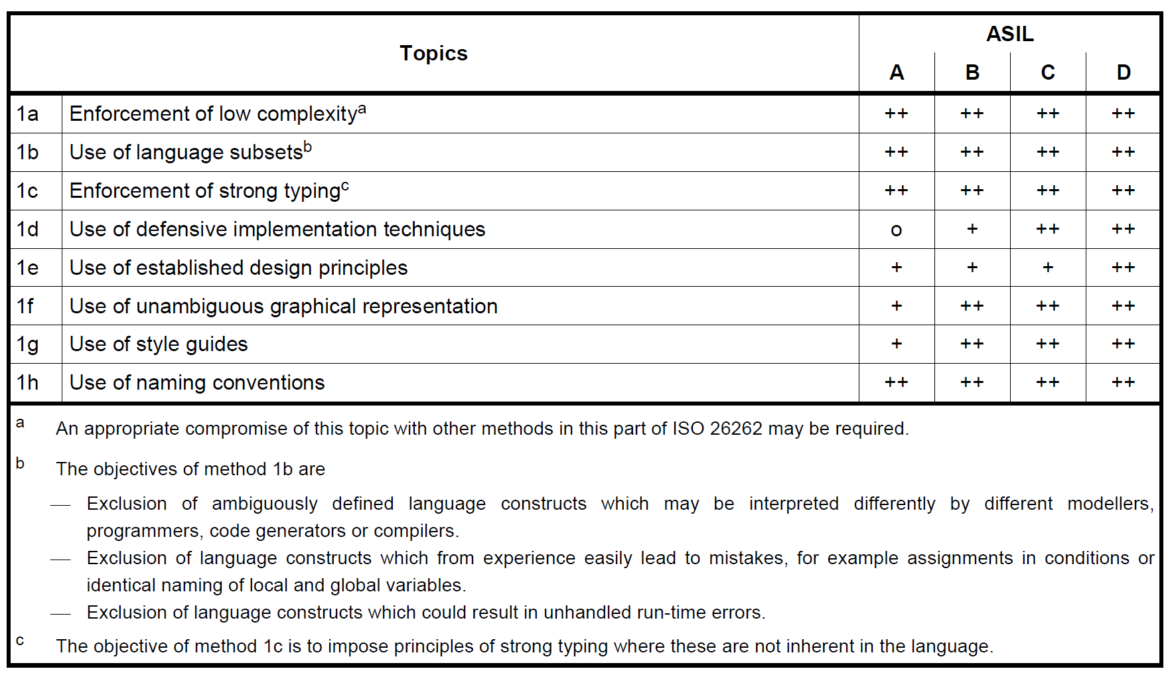
Modelling and Coding Guidelines

Slide 38
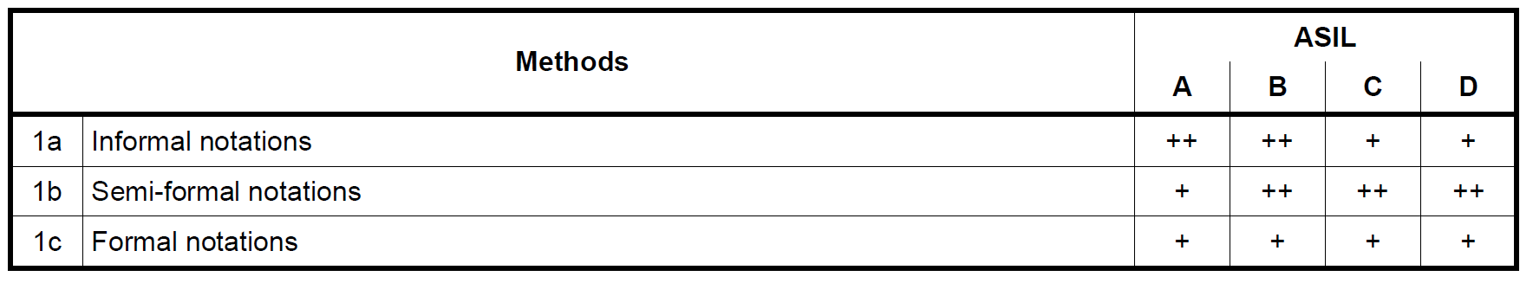
Design notations

Slide 39
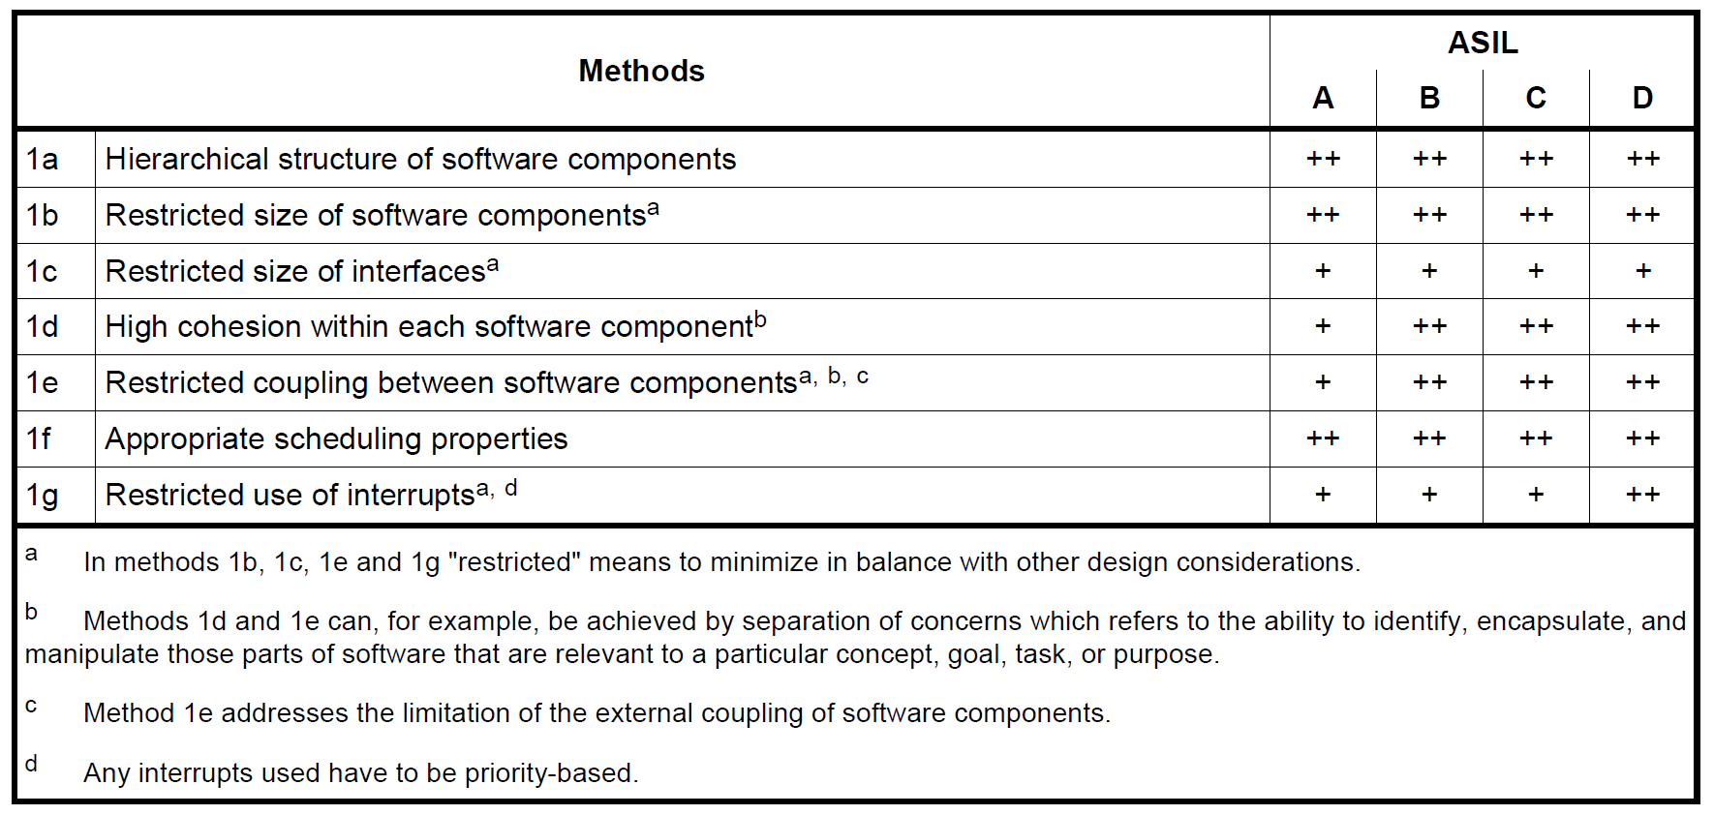
SW architecture design

Slide 40
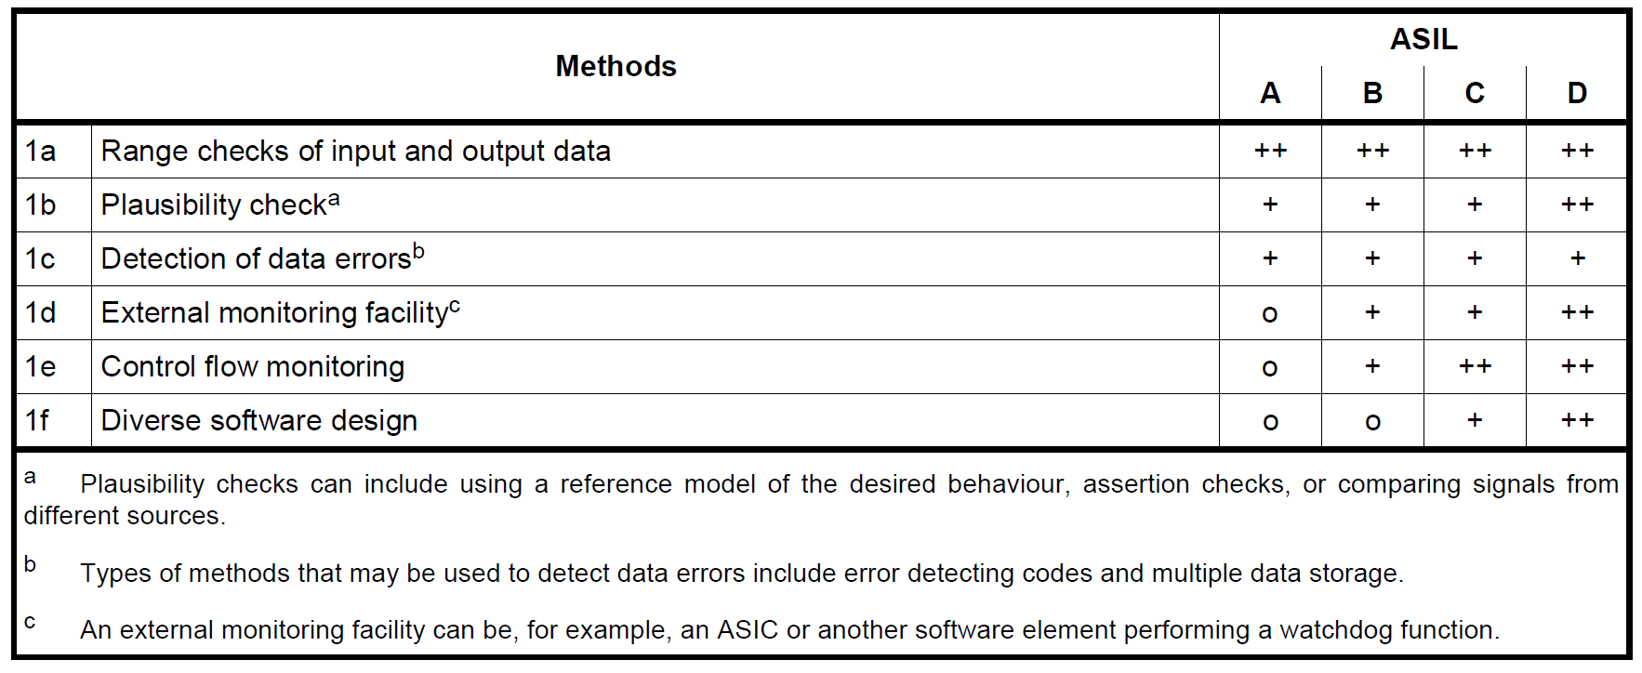
Error detection at architectural level

Slide 41
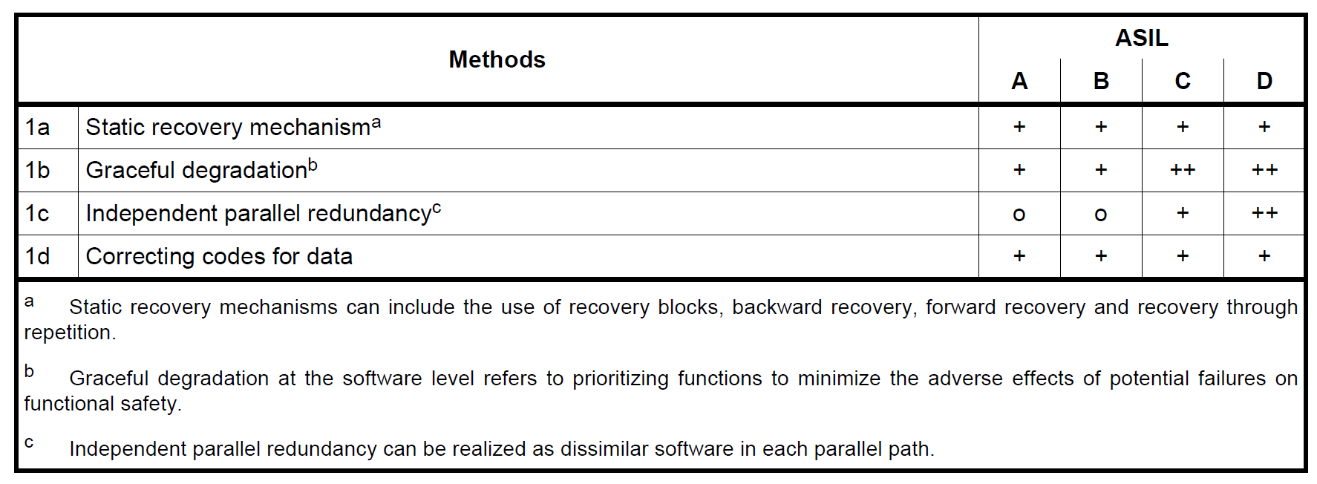
Error handling at the architectural level

Slide 42
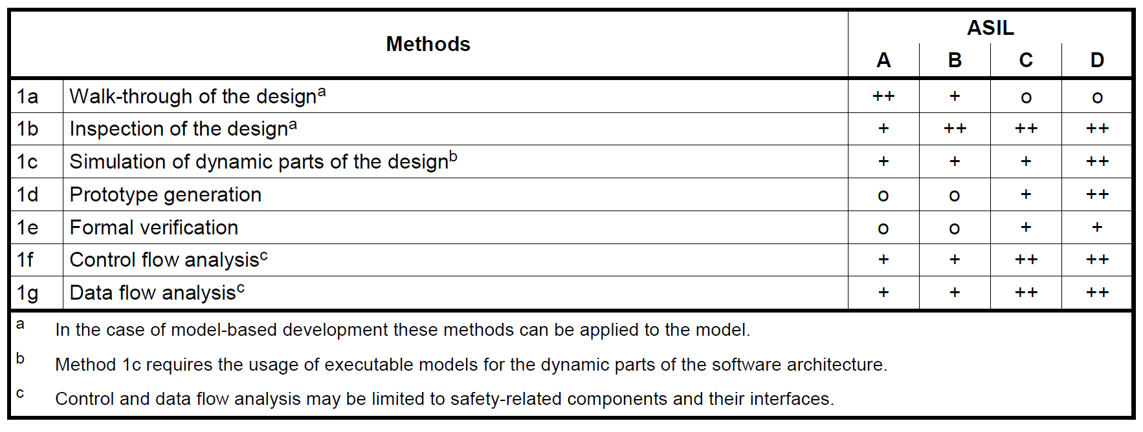
Verification of the SW architectural design

Slide 43
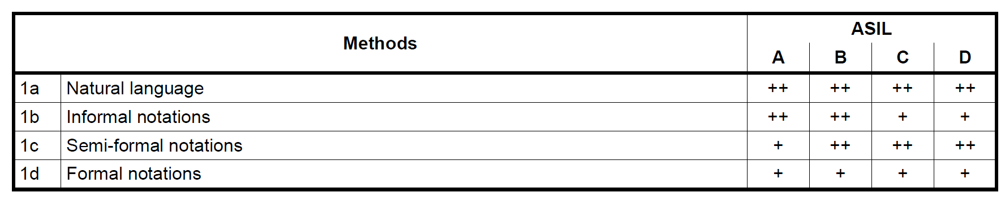
Notations for SW unit design

Slide 44
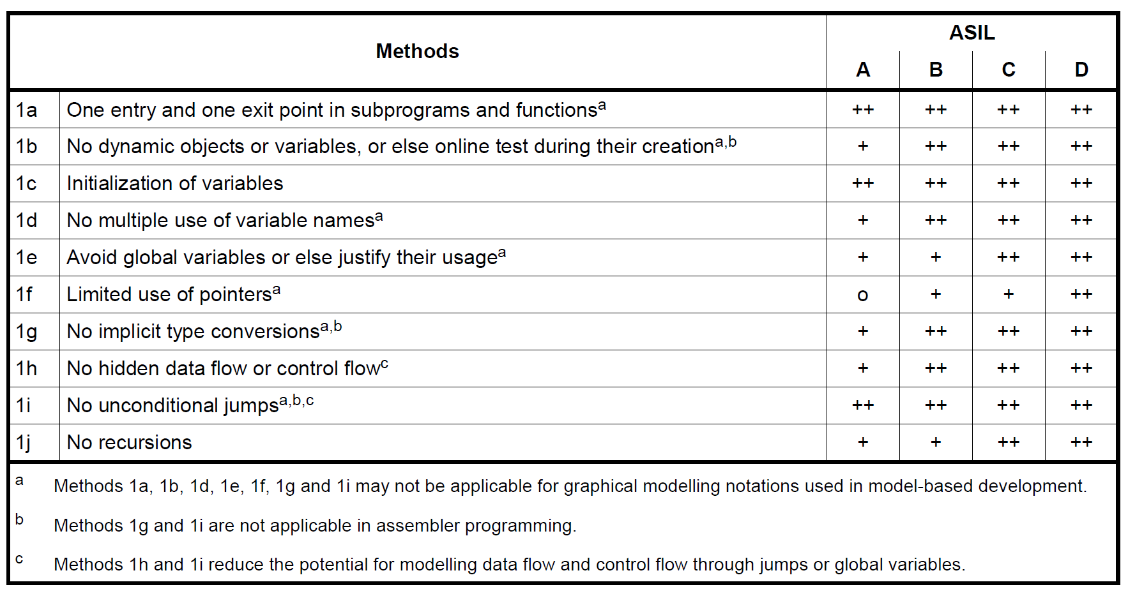
Unit design principles

Slide 45
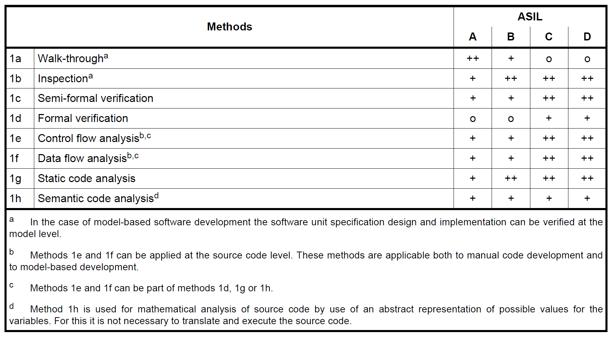
Unit-level verification

Slide 46
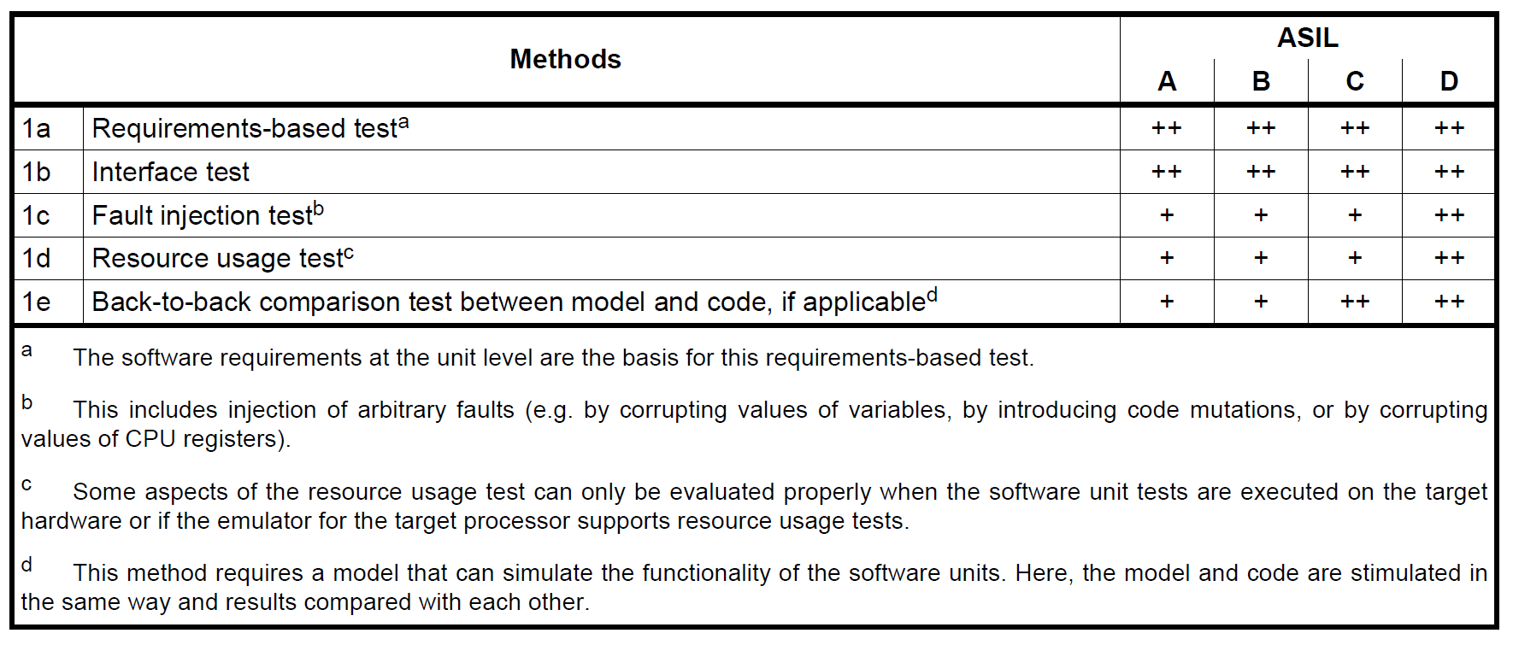
Unit testing

Slide 47
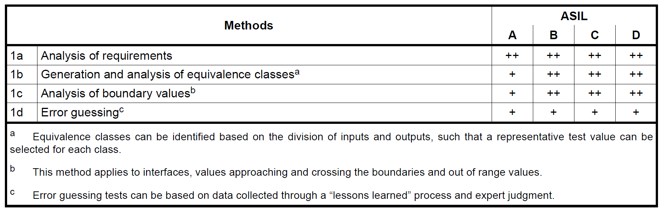
Test cases for unit testing

Slide 48
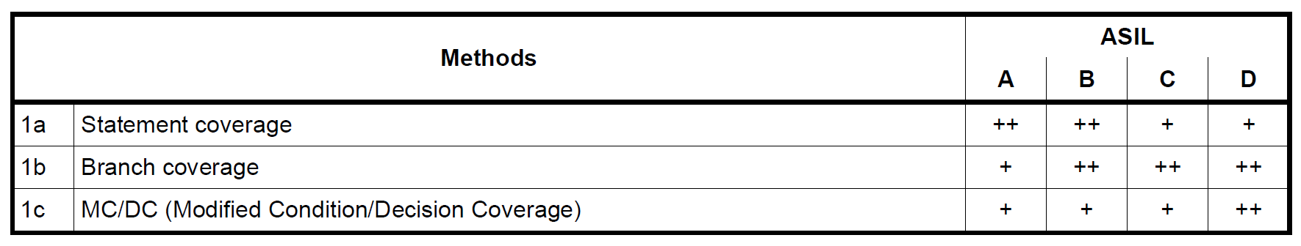
Structural coverage metrics

Slide 49
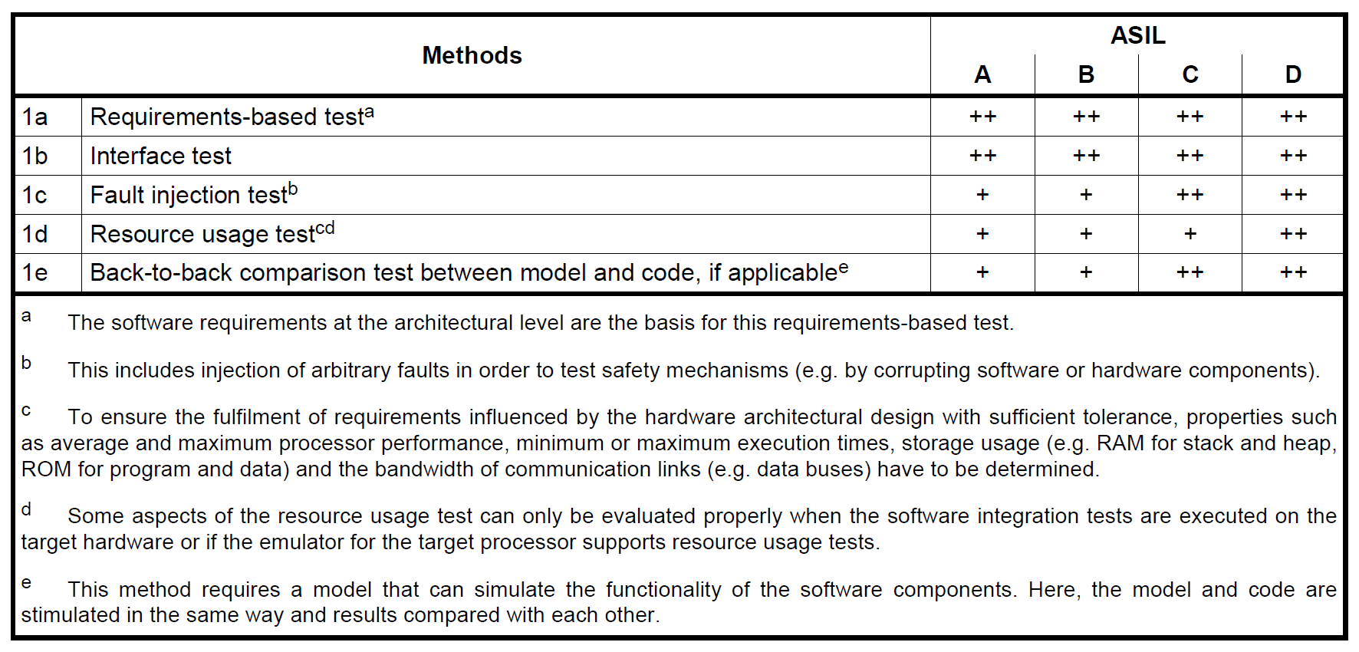
Integration testing

Slide 50
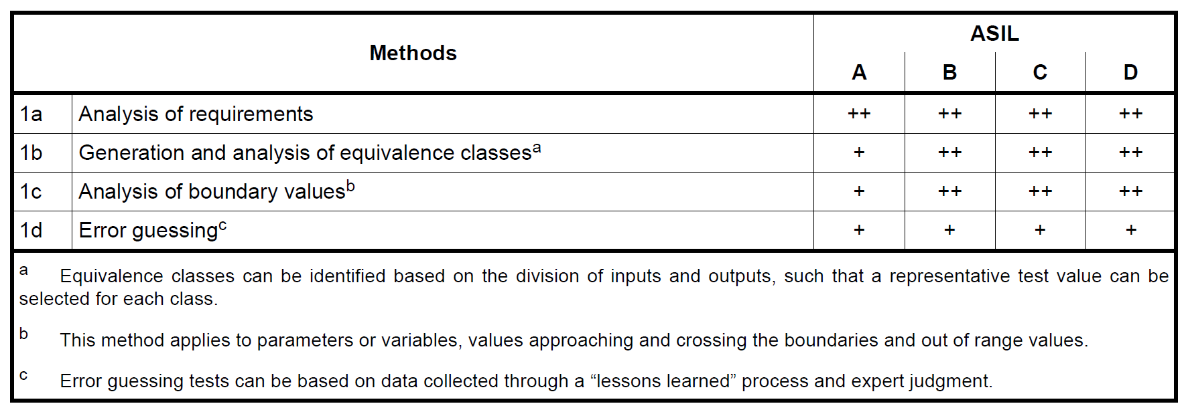
Test cases for SW integration testing

Slide 51
Independence and Freedom from Interference

Slide 52
What’s the difference?
Independence – complete absence of interplay between A and B
Freedom from Interference – failures do not propagate between A and B
Freedom from interference (FfI) is enough to argue for safety

Slide 53
“Three pillars” of FfI
Timing
Memory
Exchange of information

Slide 54
Timing
Failures to look for:
Blocking of execution
Deadlocks
Livelocks
Incorrect allocation for execution time
Incorrect synchronization

Slide 55
Memory
Failures to look for
Corruption
Read or write access denied when needed

Slide 56
Exchange of information
Failures to look for
repetition of information;
loss of information;
delay of information;
insertion of information;
masquerade or incorrect addressing of information;
incorrect sequence of information;
corruption of information;
asymmetric information sent from a sender to multiple receivers;
information from a sender received by only a subset of the receivers;
blocking access to a communication channel.

Slide 57
Outlook and Final Thoughts

Slide 58
Take home message
If you are developing a safety-relevant system, you are not alone
Things to have a look at
Systems Engineering (book by Kosiakoff is the best entry point)
Safety Engineering (books by Nancy Leveson and Joseph Miller may be of interest)
Currently System and Safety Engineering is much more a “trade” than an established engineering discipline

Slide 59
Take home message
Ask [yourself] questions, provide arguments
“Why do we think that it is OK?”
Bad arguments
The boss said so
It works
It has always been like this
“What is the state of the art?”
“How can we justify it?”
Bad arguments
Money
Time pressure

Slide 60
Take home message
Think in goals, not tools
Organize your work
Ensure that you CAN land where you want to land
Lifecycle is not a process!
Talk to each other
Safety shall not be an optional feature
Discussing safety arguments does not violate IP
Safety is a societal factor

Slide 61
Do you want to talk about it?
Oleg Kirovskii
Oleg.Kirovskii@gmail.com
Telegram: @nilometrist

Slide 62
Thank you very much for your attention!
“We decided to do it not because it’s easy, but because it’s hard”
(JFK about going to the Moon)

